Slide 1

DIABETIC RETINOPATHY DETECTION USING DEEP LEARNING
Department of Artificial Intelligence and Data Science
Under the guidance of
Mrs. K. Bhanu
By
G. Vamsi Krishna 20481A5420
R. Sai Nithin 20481A5448
V. Kondala Rao 20481A5461
J. Subash 20481A5422

Slide 2
Contents
Abstract
Introduction
Retina of Eye
Literature Review
Data Set
Methodology
Algorithms
Results
Web Application
Conclusion

Slide 3
Abstract :
Recent breakthroughs in deep learning have showed promise in the field of medical imaging and disease detection, particularly for difficult challenges such as diabetic retinopathy, a severe condition characterized by uncontrolled and aberrant cell division in the retina. The purpose of this study is to use convolutional neural networks for image processing and data augmentation to identify between regions with and without diabetic retinopathy in diabetic patient’s retinal pictures. Using the transfer learning approach, the study goes on to assess how well a new CNN model performs in comparison to well-known pre-trained models like VGG-16, ResNet-50, MobileNet, and EfficientB0.

Slide 4
INTRODUCTION:
Diabetic retinopathy occurs when diabetes damages the tiny blood vessels in the retina.
It can cause “blind spots,” blurry vision, and vision loss.
Vision may change from day to day, or even from morning to evening.
This “fluctuating vision” can interfere with many, if not most, everyday activities.
According to previous studies, the latest experimental results of the former DR scale can be obtained, but the latter is not used for the experimental classification of maculopathy. The enormous amount of annotated images needed for model learning is a significant barrier to the widespread and successful usage of deep learning systems.

Slide 5
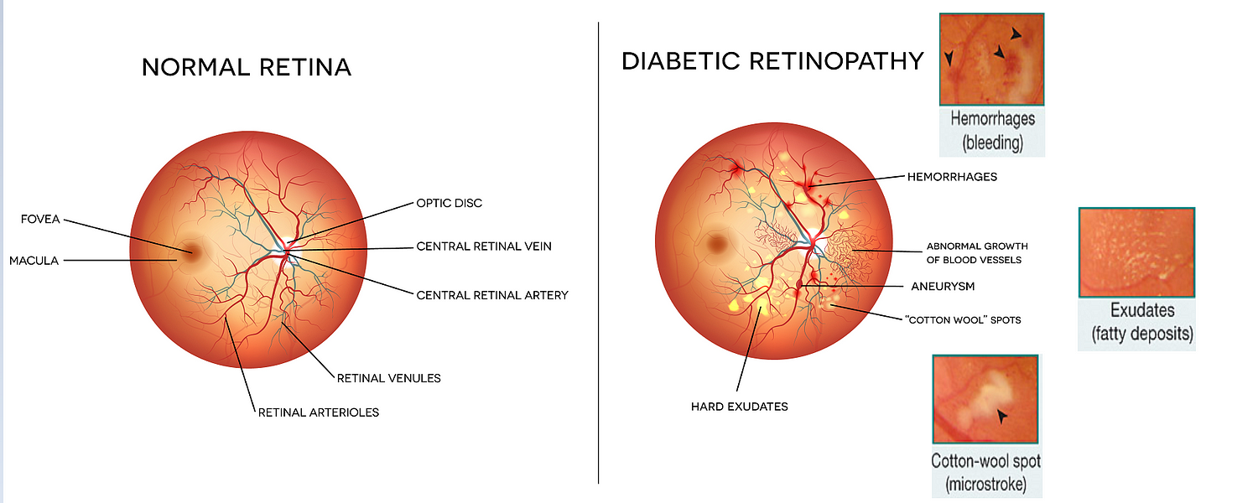
Retina of an Eye

Slide 6
LITERATURE REVIEW:
Michaelides et al. conducted a randomized trial comparing intravitreal bevacizumab and laser therapy for managing diabetic macular edoema. The study measured visual acuity over a 12-month period. Results were influenced by illness severity and patient demographics, emphasizing the need for careful interpretation and further research.
Gulshan et al's JAMA paper discusses the development and validation of a deep learning system for detecting diabetic retinopathy in retinal fundus images. The system uses a convolutional neural network architecture for feature extraction and classification. Limitations include interpretability, biases, and need for updates.
Ozieh et al.'s research examines healthcare spending patterns among American diabetes patients, focusing on financial implications and policy implications. The study uses datasets like the Medical Expenditure Panel Survey and includes analysis of healthcare utilization trends, direct expenditures, and variables.

Slide 7
PROBLEM STATEMENT:
Automated Detection: Develop a deep learning model capable of automatically detecting diabetic retinopathy from fundus images, eliminating the need for manual screening and reducing the time and cost associated with diagnosis.
Severity Classification: Implement a classification system within the model to categorize detected cases of diabetic retinopathy into different severity stages (mild, moderate, severe, proliferative), enabling tailored treatment plans and interventions based on the severity of the condition.
Address Data Imbalance: Employ techniques to mitigate data imbalance issues within annotated datasets, ensuring that the model is trained effectively across all severity stages of diabetic retinopathy and yielding more accurate predictions, particularly for minority classes.
Validation and Compliance: Conduct rigorous validation studies to assess the model's performance, including cross-validation on diverse datasets and comparison with manual grading systems. Ensure compliance with medical regulations and standards, such as FDA approval and data privacy regulations, to ensure the legality, safety, and ethical use of the developed solution in clinical settings.

Slide 8
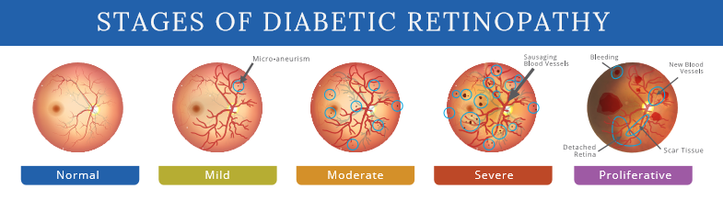
DATA SET:
The clinicians have rated each image for the severity of diabetic retinopathy on a scale of 0 to 4. It is a multi-class problem with above 5 target classes.
Type of DR | Scaled Value
NO_DR | 0
Mild_DR | 1
Moderate_DR | 2
Severe_DR | 3
Proliferative_DR | 4

Slide 9
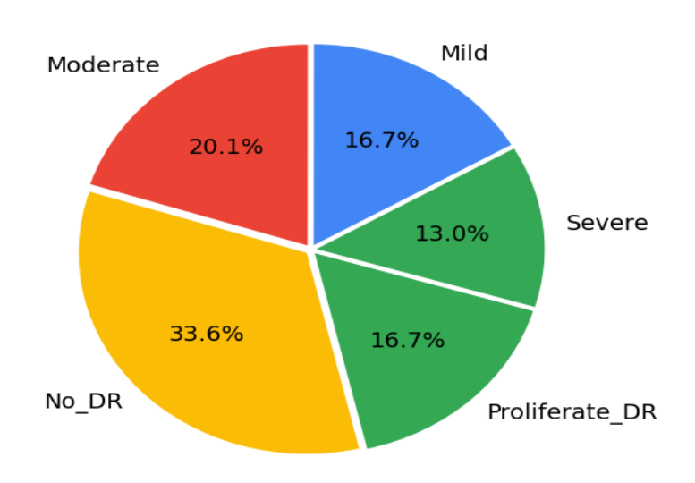
DATA SET:

Slide 10
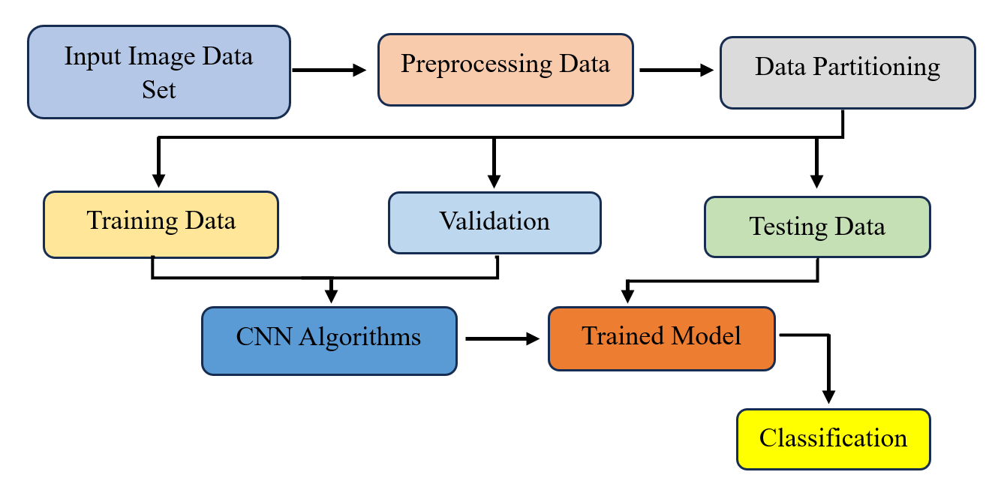
METHODOLOGY:
An emphasis on speed, precision, and real-time processing characterises the suggested method for identifying and managing diabetic retinopathy in retinal pictures. In order to improve the model's resilience and make the most of the available training data, the method makes use of ImageDataGenerator for data augmentation. By applying random modifications to training images, this method enhances the generalisation capabilities of the model. The method also incorporates additional pre-trained models, such as ResNet50, VGG16, MobileNetV2, and EfficientB0, to further expand its capabilities. Using pre-trained weights from the ImageNet dataset speeds up training and improves model performance.

Slide 11
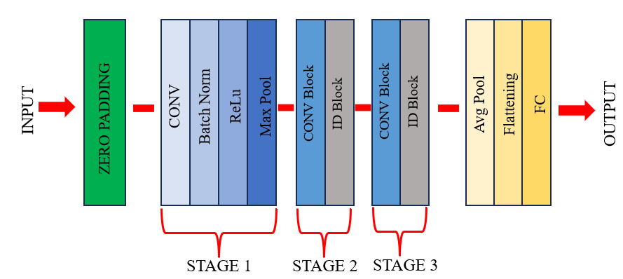
RESNET50:
Feature Extraction: ResNet50's initial layers extract low-level features such as edges and textures from fundus images, crucial for capturing unique retinal lesions in diabetic retinopathy.
Hierarchical Representation: As the network progresses, deeper layers learn increasingly abstract features, enabling discrimination between different severity stages of diabetic retinopathy.
Transfer Learning: Pre-trained ResNet50 models, initially trained on large-scale datasets like ImageNet, can be fine-tuned on diabetic retinopathy data to adapt learned features to retinal pathology characteristics.
Classification: The final layers of ResNet50 facilitate classification of fundus images into severity categories (e.g., mild, moderate, severe, proliferative), providing automated diagnosis and risk assessment.

Slide 12

VGG16:
One of the most effective and straightforward deep learning models is the VGG16 (Visual Geometry Group 16) architecture. VGG16, which consists of 16 layers, uses 3x3 convolutional filters with small strides and max-pooling layers. Especially, VGG models like VGG16 are praised for their strong feature extraction powers. Because of its repeating and layered layer architecture, VGG16 is a popular choice for a variety of computer vision tasks, especially in medical picture analysis.VGG16 is utilised in the particular context of the previously mentioned project for classification tasks pertaining to diabetic retinopathy.

Slide 13
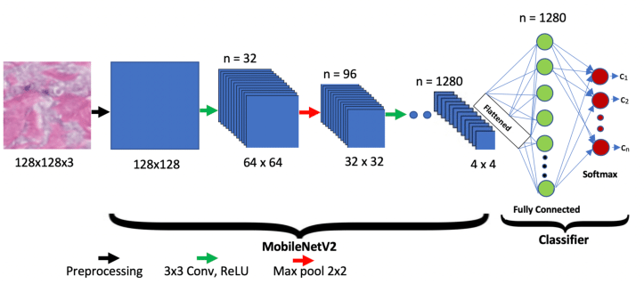
MOBILE NET V2:
An important tool in the context of the endeavour in concern is MobileNetV2, an extension of the MobileNet architecture created especially for embedded and mobile vision applications. Because of its efficient and lightweight architecture, MobileNetV2 is especially useful for mobile devices that operate in contexts with limited resources. Especially in healthcare applications, its efficiency is critical for real-time photo analysis. MobileNetV2 is a logical candidate for implementing AI-driven diagnostic tools in the medical area because of its versatility and resource-friendly nature, particularly in the project's focus on diabetic retinopathy classification.

Slide 14
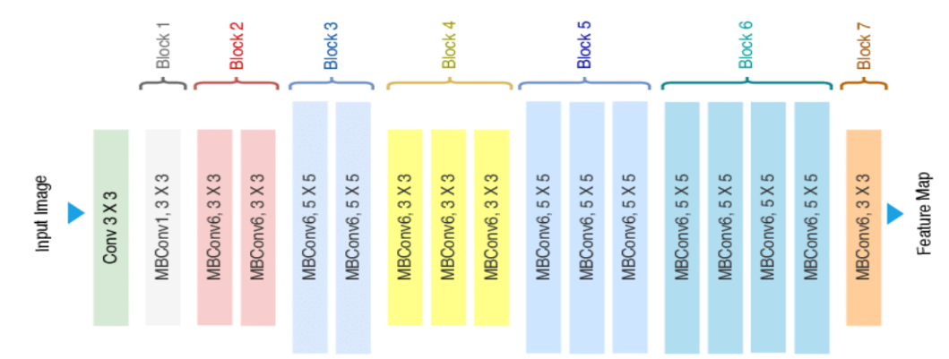
EFFICIENT NET B0:
Within the family of EfficientNet models is the convolutional neural network architecture known as EfficientNetB0. It has become well-known for its abilities in picture classification and feature extraction, among other computer vision applications. The architecture is made to maximise computational resources by balancing the model's width, depth, and resolution. This model uses 7 inverted residual blocks and Swish activation function. The reason why these models perform so well is because it does not solely focus on scaling for depth like the Res Net models. Here width, resolution and depth are all scaled in a compound manner leading to better results. This model servers as a base for the family of Efficient Net models that range from EfficientNet-B0 to EfficientNet-B7. The Efficient Net family of models is probably the most advance CNN architecture because it achieves high accuracy while using a considerably smaller number of parameters

Slide 15
RESULTS:
Of the four architectures used it is clear that shown in Table 2 and Fig. 8, EfficientNetB0 had the best accuracy (95.39%) in the context of classifying diabetic retinopathy. It was expected to perform better because it was the newest and most advanced architecture. Additionally, ResNet50, VGG16, and MobileNetV2 demonstrated exceptional accuracy, consistently averaging 91%. Notably, MobileNetV2 demonstrated its effectiveness with a noteworthy accuracy of 91.88% using the fewest parameters. Nonetheless, VGG16 encountered difficulties in correctly detecting diabetic retinopathy, which may have been related to the small dataset consisting of MRI images from three different perspectives (sagittal, coronal, and axial). The comparatively small number of photos for each view and class limited the model's ability to learn.
Model Name | Precision | Recall | F1 Score | Accuracy
ResNet 50 | 0.926320 | 0.924320 | 0.933200 | 0.933440
VGG 16 | 0.894000 | 0.883330 | 0.890040 | 0.897730
MobileNet | 0.945450 | 0.919900 | 0.915320 | 0.918870
EfficientNet B0 | 0.946543 | 0.944578 | 0.954454 | 0.953900

Slide 17
Web Application:
The Diabetic Retinopathy Detection Web Application is a Flask-based web application developed to assist in the early detection of diabetic retinopathy, a complication of diabetes that can lead to blindness if left untreated. This application utilizes Deep learning algorithms to analyse retinal images and provide predictions regarding the presence and severity of DR.
Features:
User-friendly Interface: The web application provides a simple and intuitive interface for users to interact with.
Image Upload: Users can upload retinal images for analysis.
Prediction Display: Upon image upload, the application provides predictions regarding the presence and severity of diabetic retinopathy.
Technologies Used:
Flask: Flask is a lightweight WSGI web application framework in Python used for building web applications.
HTML/CSS: Used for designing and styling the user interface.
Deep Learning: Deep learning algorithms are employed for analyzing retinal images and making predictions.
Libraries: Libraries such as TensorFlow, Kereas, and scikit-learn are utilized for image processing and machine learning tasks.

Slide 18
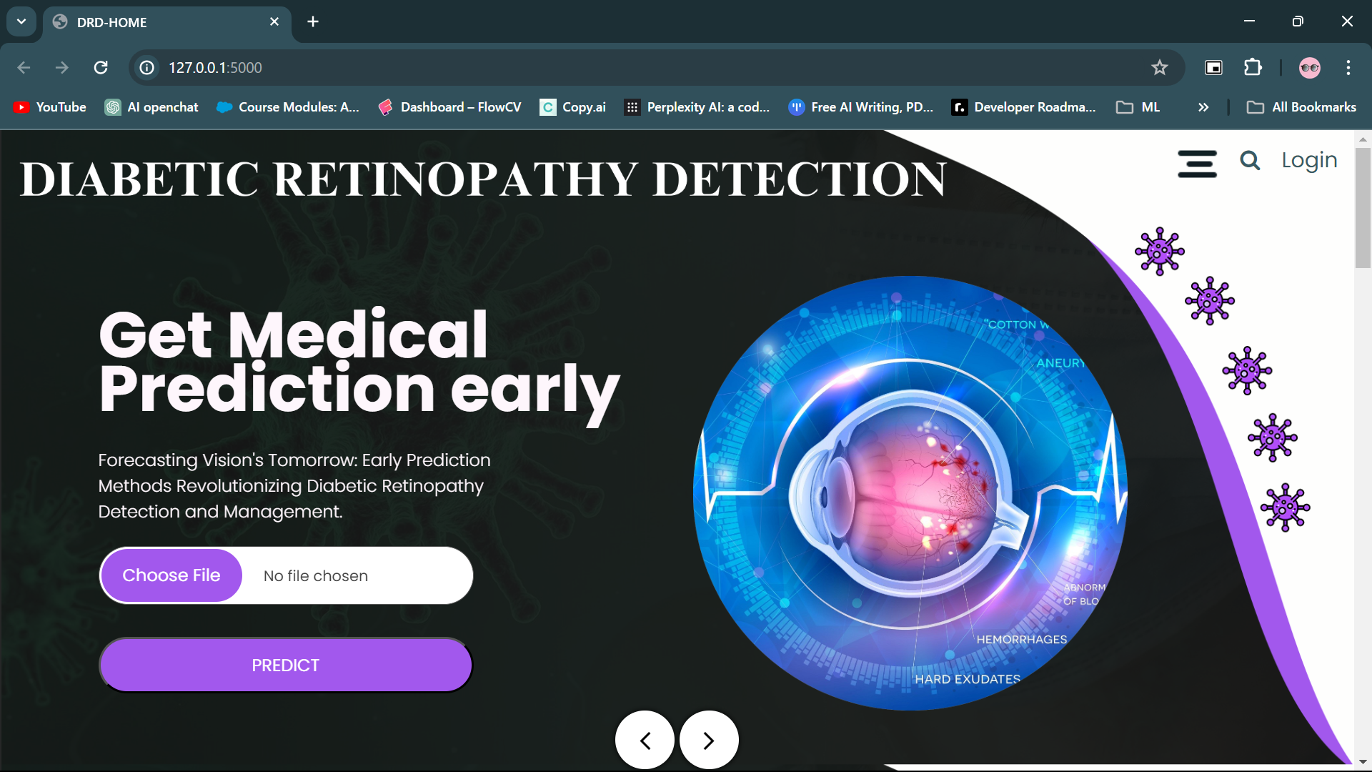
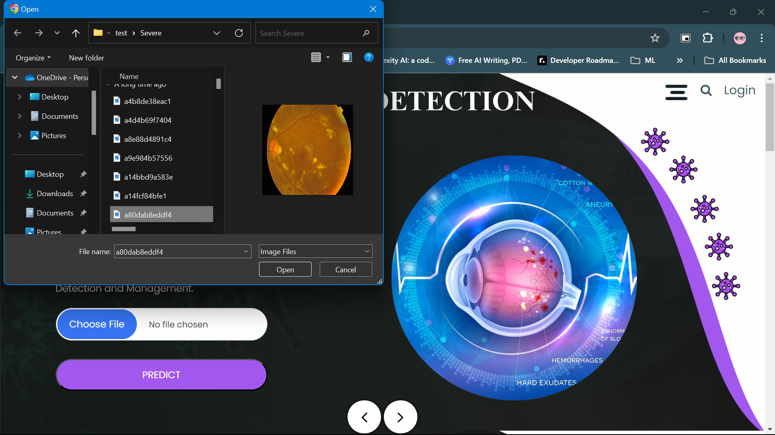
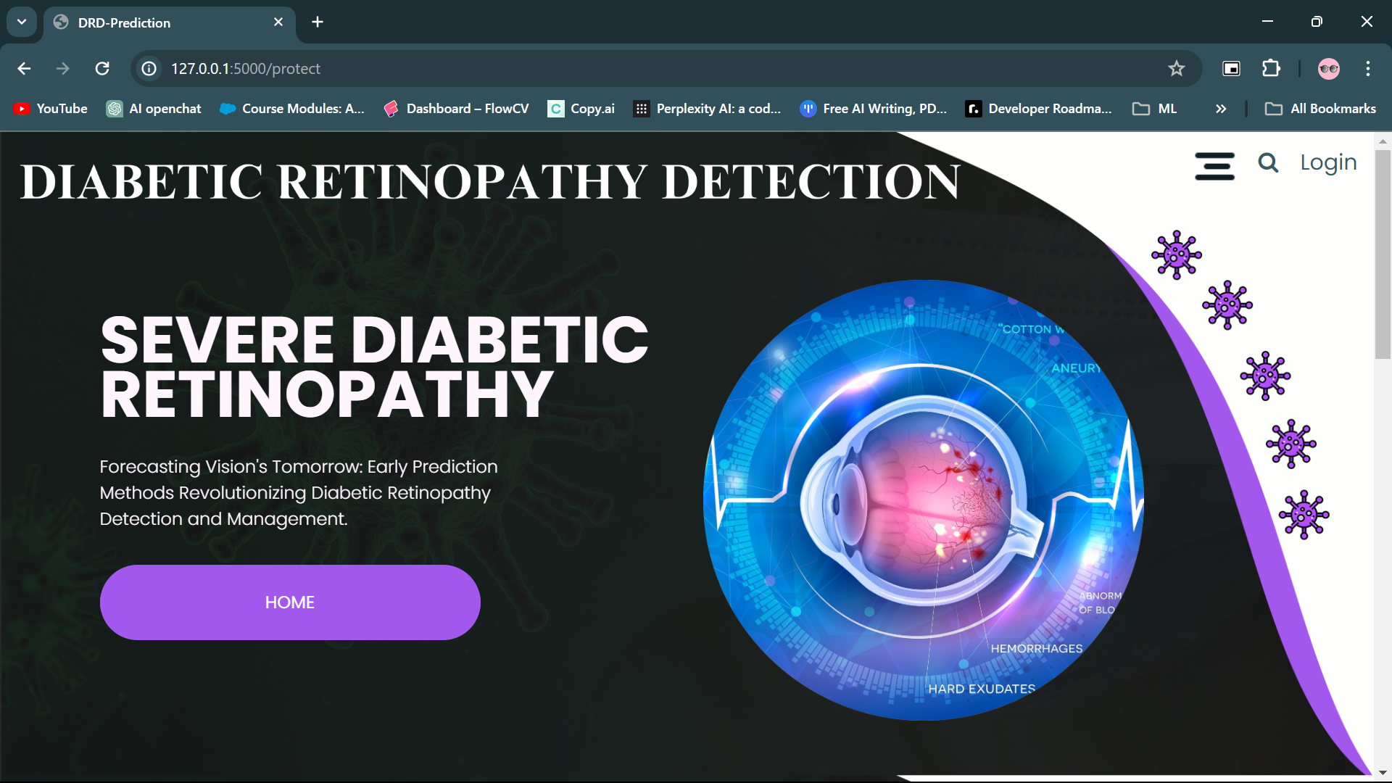
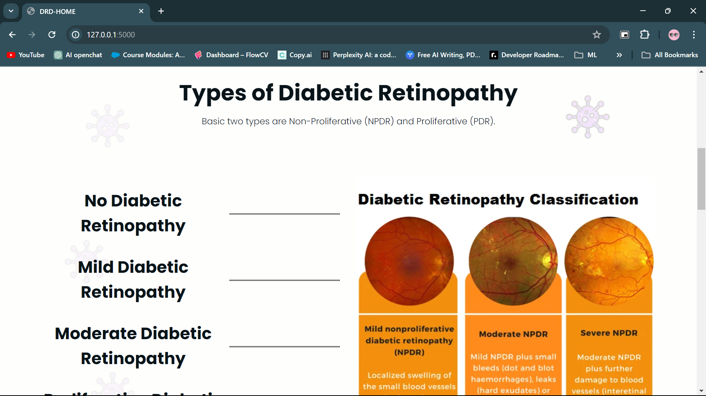

Slide 19
CONCLUSION:
In conclusion, the experiment that was shown shows how well deep learning models more especially, EfficientNetB0, ResNet50, VGG16, and MobileNetV2 work when it comes to classifying diabetic retinopathy in images of the retinal fundus. The models display excellent accuracy percentages; EfficientNetB0 leads the pack with an astounding 95.39%. The models' strong performance is a result of the use of pre-trained models, transfer learning, and careful consideration of data augmentation. The use of EfficientNetB0, which is renowned for its accuracy and efficiency, makes it stand out as a potent instrument for the real-time identification of diabetic retinopathy, in line with the rising demand for precise and efficient medical solutions. Furthermore, analyzing various architectures offers insightful information about their performance attributes. Although EfficientNetB0 is the best performer, the comparison analysis shows that ResNet50, VGG16, and MobileNetV2 have advantages and disadvantages. In the field of diabetic retinopathy diagnosis, the study emphasizes the significance of utilizing cutting-edge deep learning architectures. This will lay the groundwork for future developments in medical image analysis and support continuous efforts to improve healthcare diagnostics.

Slide 20
THANK YOU!

